Slide 1


Clustering Assignment
Prepared by: [Your Name Here]
Prepared by: Shawn Shakiba

Slide 2
Data & Feature Engineering
Merged FREDWeighted.csv and USRecessionData.csv on the 'DATE' column.
Set the index of the merged DF to date values. Note that date field is not a feature
Dropped rows with more than 5 missing values and columns with over 10% missing data.
Replaced any value in the dataframe that is inf (for infinity) with NaN (not a number).
US Recession Data was removed from the features. A new df was created with the remaining df called X_merged.
US Recession Data was used to create y_merged.
X_merged contains 85 NaN values.

Slide 3
Data & Feature Engineering (Data Pipeline)
There is no non numeric columns in X_merged.
Nan values will be imputated using the Median strategy, to avoid changing the distribution of our data.
Because of the potential skewedness of data points, data was scaled with Power transformers as opposed to standard scaler
Pipeline process was defined for the dataset. X_merged is fitted and transformed based on the pipeline and is stored in a variable called X.
The shape of X is (778, 123).

Slide 4
TSNE
TSNE was used for 2D visualization of X and y after Transforming the data. This allows for reducing the dimensionality of the data while preserving the original structure.
TSNE of original data was plotted while extracting the labels for each point from y_merged (US Recession). The following slide contains a visualization of TSNE.
The plots shows clusters of recession and non recession rows in the data, while the dimensionality is reduced for better insights.
This visual can be helpful to see if there are any obvious clustering of data.

Slide 5
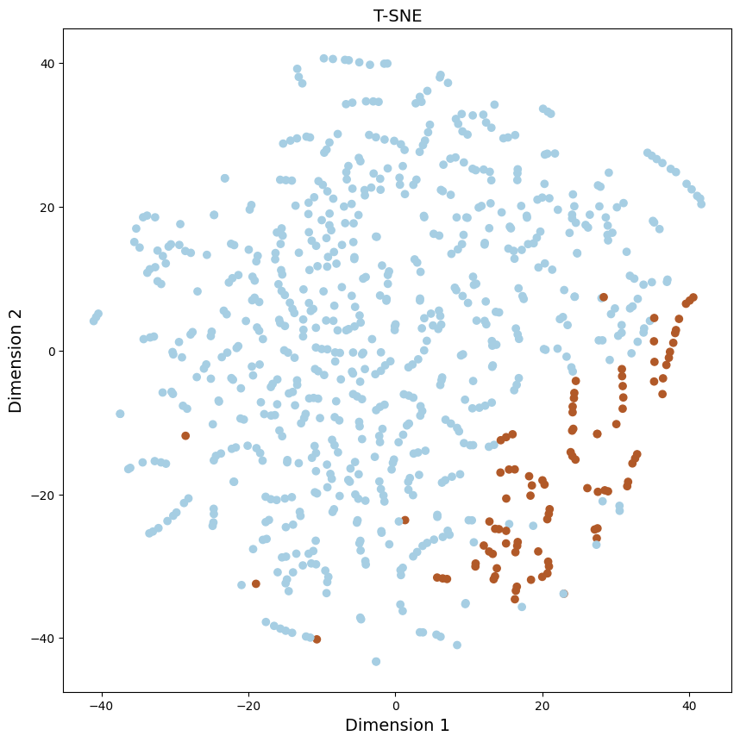
TSNE

Slide 6
Cluster Analysis: K-Means
Inertia and silhouette scores were plotted using the function inertia_silhouette_plot to find out ideal K values for this assignment
To determine the ideal value of k, one typically looks for a balance between low inertia and a high silhouette coefficient.
The following visuals represent the inertia and silhouette analysis.

Slide 7
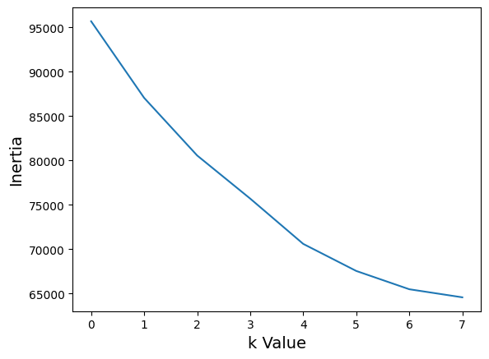
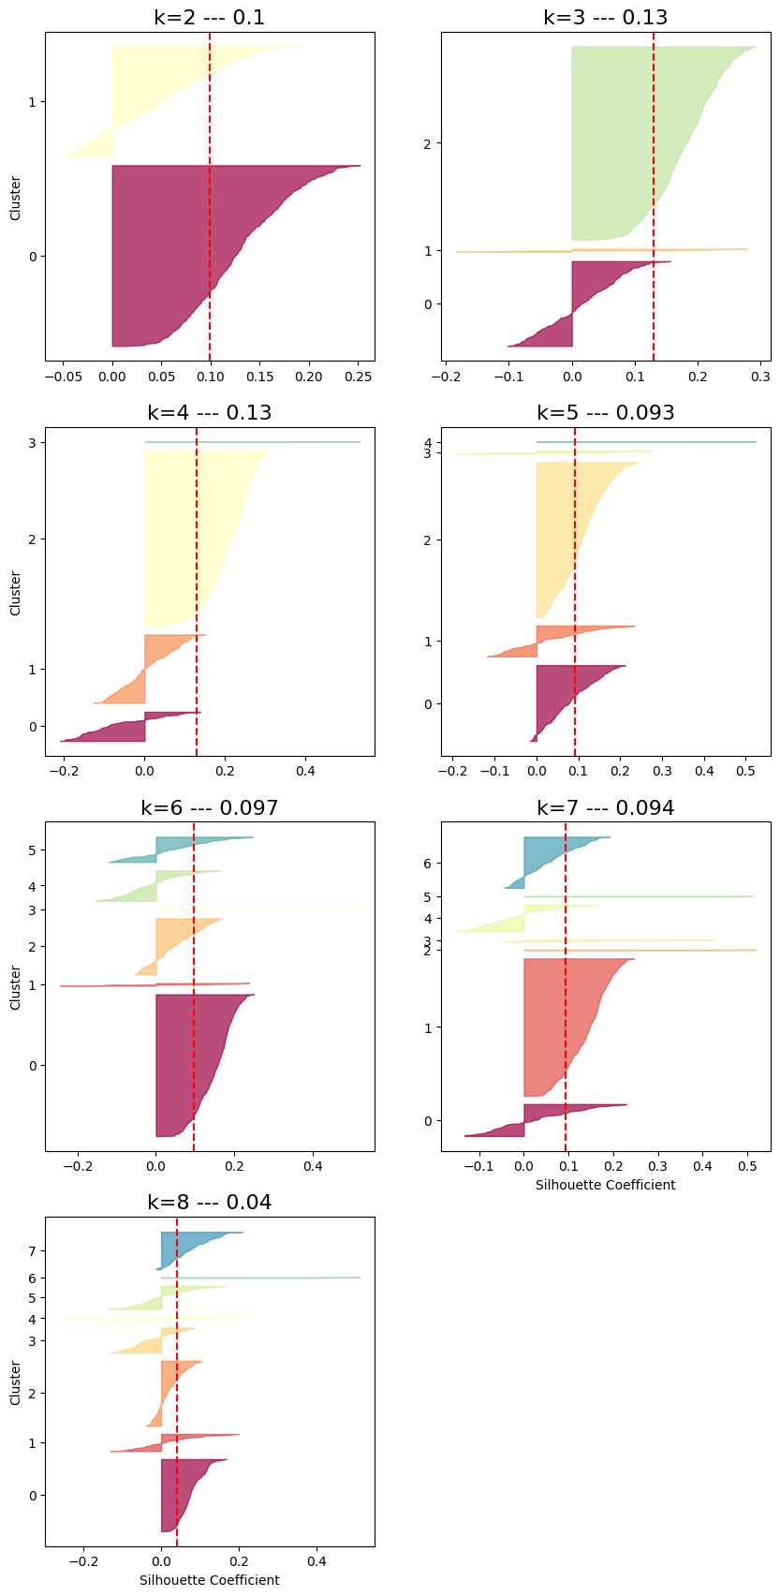
Cluster Analysis: K-Means

Slide 8
Cluster Analysis: K-Means
Since K = 3 and K =4 have the same silhouette score, two different models with K = 3 and K = 4 were created to evaluate which k value is optimal.
The histogram of different clusters were plotted to gain better insight on how the algorithms are clustering.
The next step would be to understand which cluster captures recession data.
TSNE was plotted for K-means model with K value of 3 and 4 and was compared to TSNE of US_Recession data.

Slide 9
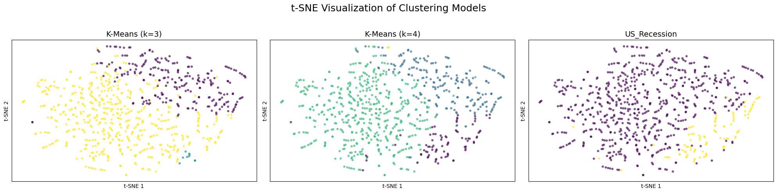
Cluster Analysis: K-Means
The visual representation bellow indicates that k = 4 can cluster the data in a way that matches the shape of recession months well.
In the far right plot, yellow values correspond to recession months. The plot in the middle seems to be able to capture that cluster (purple values). In the next step, cluster are mapped to a recession value of zero or one.

Slide 10
Cluster Analysis: K-Means
Based on the previous plots, and considering that cluster zero that is predicted by the model and actual number of months that US was in a recession has similar numbers of values, it was decided to map cluster zero to equal to recession months (or 1), and every other cluster to non recession month (or 0).
The result of this mapping was stored in a column called 'KMean_Pred_4’. When TSNE is plotted for the clustering algorithm ('KMean_Pred_4) and actual US recession data, we get the following visualization indicating that this algorithm has done a decent job of predicting recession.

Slide 11
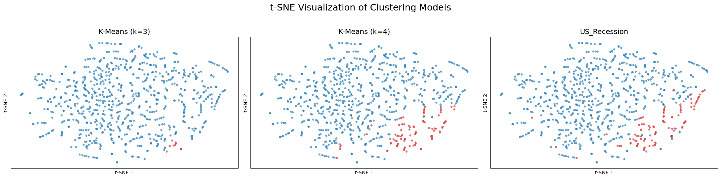
Cluster Analysis: K-Means
Please note that although K-Means with k = 3 did not performed as well, it is still included in the analysis.
Following this analysis, a histogram was plotted against the date with green representing actual recession months and light orange representing predicted recession months by the K_means model with K = 4.

Slide 12
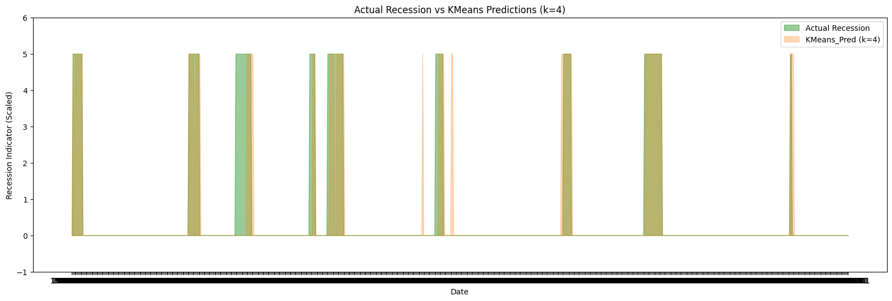
Cluster Analysis: K-Means

Slide 13
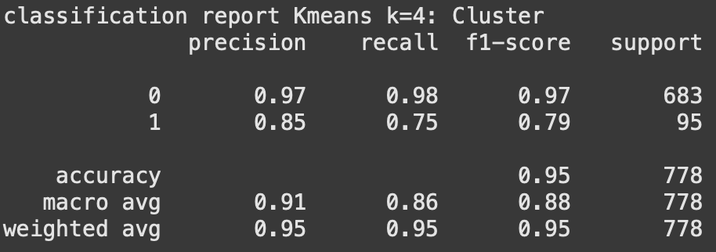
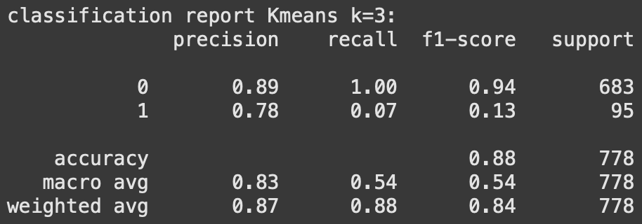
Cluster Analysis: K-Means
K-means with k = 4 predicted 84 recession months out of 95.
The following classification reports compares K = 3 and K = 4, further re-enforcing the fact that k = 4 makes the model perform better.

Slide 14
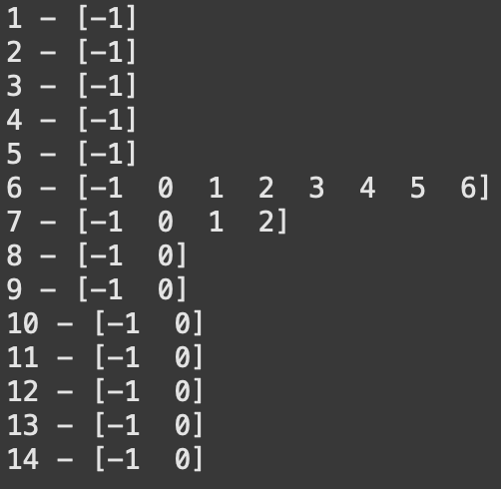
Cluster Analysis: DBSCAN
To determine a good epsilon value, Avg. Distances to Nearest Neighbor was plotted to find the elbow point. The graph is depicted in the following slide.
After that, a loop is implemented to find a good eps value (trying values from 1-15) and number of clusters. The results of the loop are depicted here.
Eps value of 6 results in 7 clusters + an outlier cluster possibly indicating overfitting.
Eps value of 7 results in the same number of clusters (3) as our K-means model + an outlier cluster. Eps value of 7 was judged to be a good value to proceed.

Slide 15
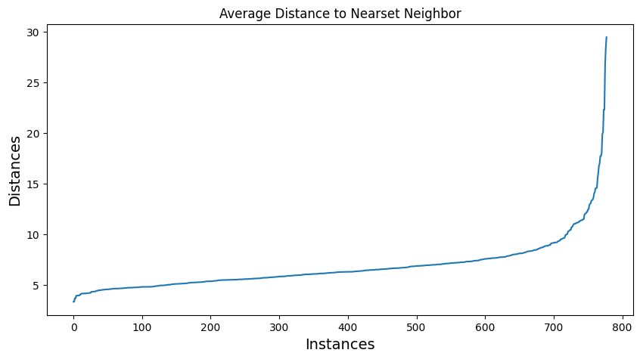
Cluster Analysis: DBSCAN

Slide 16
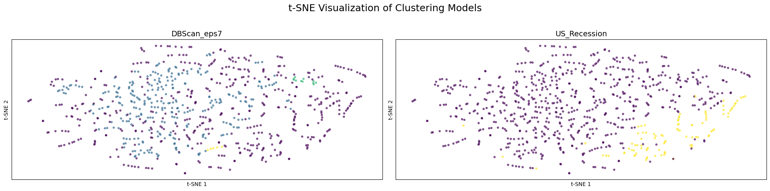
Cluster Analysis: DBSCAN
After running DBSCAN with eps = 7, the model came up with 473 outlier values, 289 values for cluster 0, 11 values for cluster 1 and 5 values for cluster 2.
TSNE visualization was used to compare DBSCAN clustering with actual US recession months. As the visual indicates, DBSCAN’s clusters do not line up well with the actual US recession months. Since the clusters are very scattered, DBScan was not mapped to actual recession values to generate a classification report.

Slide 17
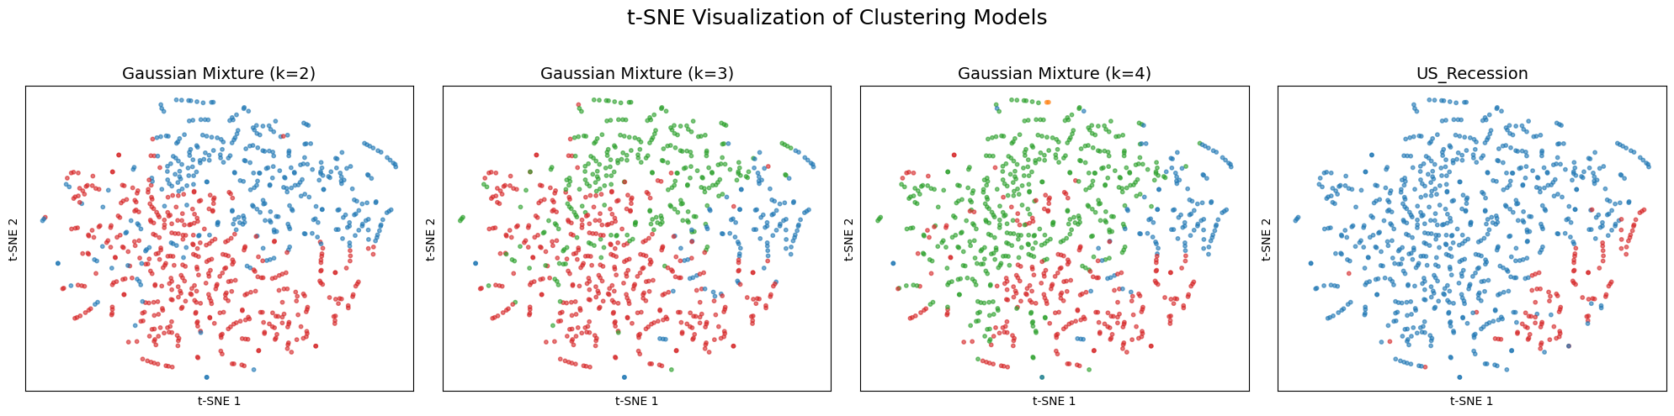
Cluster Analysis: Gaussian Mixture Model
Based on BIC and AIC graph depicted in the next slide, a few k values were chosen to experiment with.
K values ranging from 2 to 4 were selected, and fit_predicted on the X dataset.
For each K value, a histogram was drawn to further analyze the cluster, and their count.
Finally, the following TSNE visualization was drawn to compare different k values in the Gaussian Mixture Model with actual US recession data.
.

Slide 18
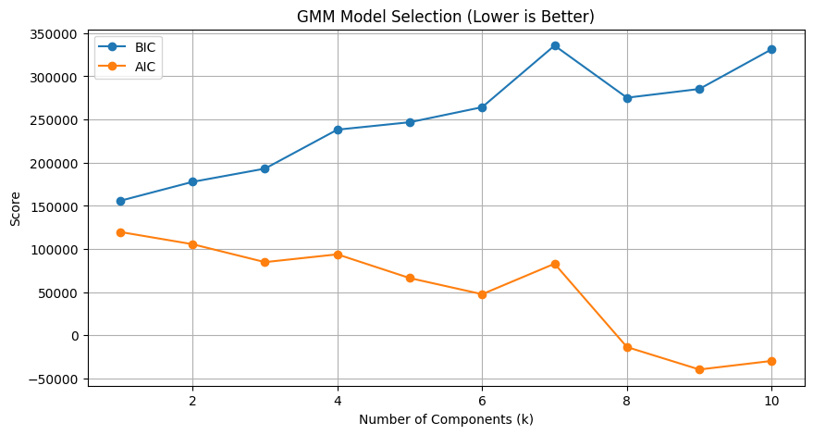
Cluster Analysis: Gaussian Mixture Model

Slide 19
Cluster Analysis: Gaussian Mixture Model
Finally for each instance of the model with different K-values, the clusters were mapped to US recession data.
For GMM with k=3, the smallest cluster was mapped to indicate US recession.
For GMM with k = 4, clusters zero and one were mapped to indicate US recession.
The following classification reports evaluates the models performance in predicting US recession.
Finally, the resulting predictions after mapping was graphed in the form of a TSNE plot to visualize the models predictions. The visual is depicted in the slide after classification reports.

Slide 20
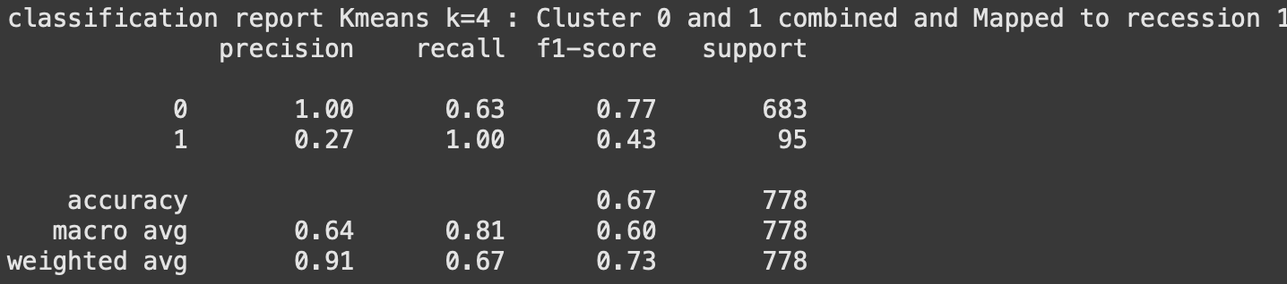
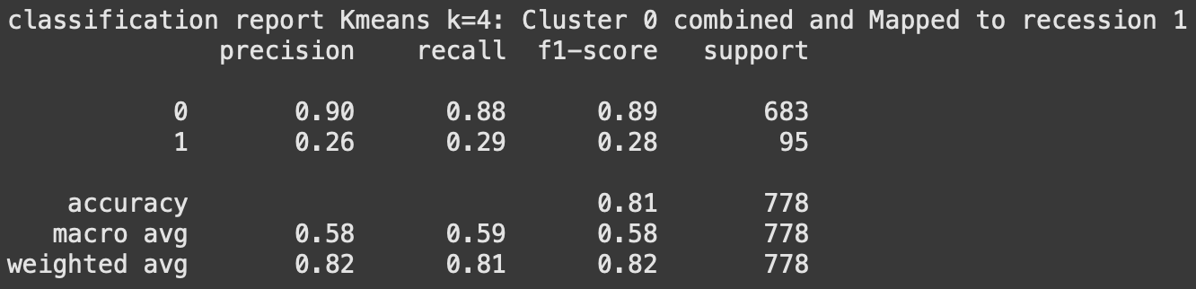
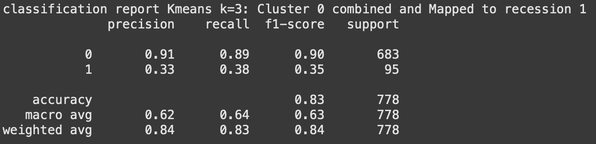
Cluster Analysis: Gaussian Mixture Model

Slide 21
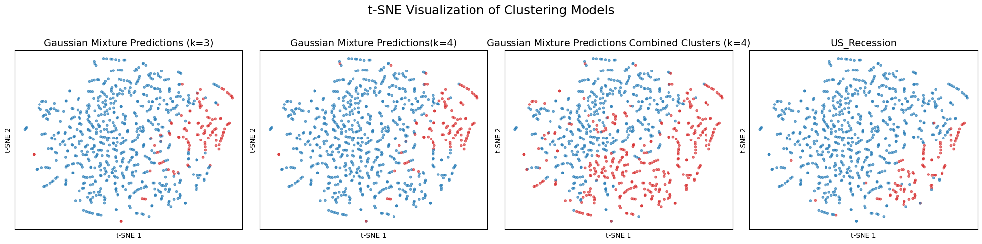
Cluster Analysis: Gaussian Mixture Model

Slide 22
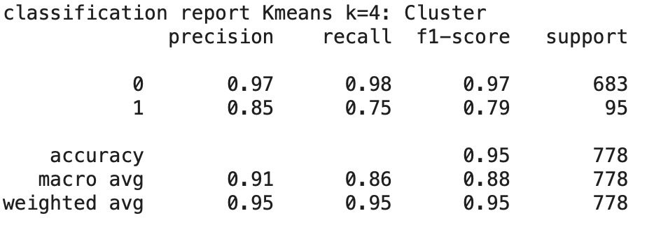
Cluster Analysis: “Best” Model
KMeans outperformed DBSCAN and GMM in identifying recession months.
The model achieved higher precision and recall, particularly for the minority (recession) class.
The histogram on slide 12 demonstrates how well k-means with k = 4 performed.

Slide 23
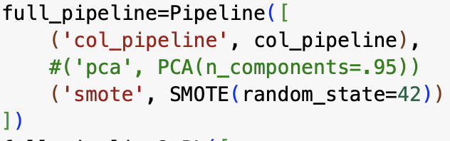
Sampling To Overcome Imbalanced Data
To overcome the challenge of imbalanced data, oversampling using smote was implemented in the pipeline.
The required modules were imported from imblearn library.
The original X has the shape (778, 123). The resampled data was stored in X_s and has the shape (1366, 123). The following code snippet shows were SMOTE was implemented in the pipeline.

Slide 24
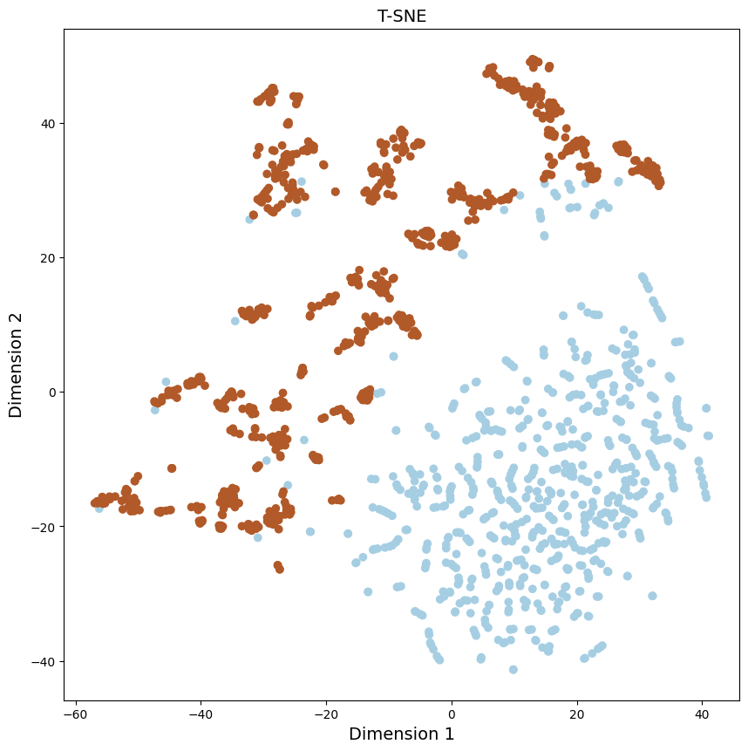
Sampling To Overcome Imbalanced Data
To further understand the effects of oversampling and verifying the oversampling was applied correctly, TSNE plot was drawn on the oversampled data.

Slide 25
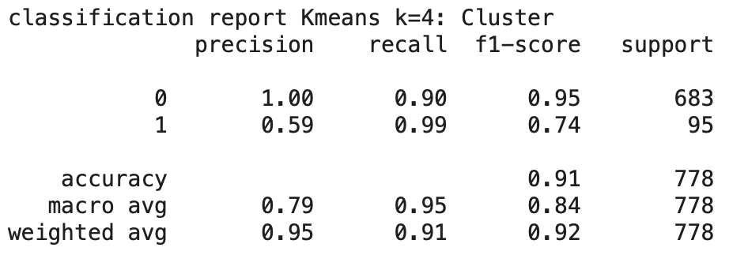
Sampling: Changes to Clusters (K-Means)
The models were trained on X_s and and the first 778 values were taken and stored in a new column of the X dataset.
The process is similar to the first part of the assignment. K-means was ran with a few different k values. The following slide depicts the TSNE graph of K means clusters (k = 4) vs actual recession values.
Classification report for K-means (k=4) with oversampling is depicted here.

Slide 26
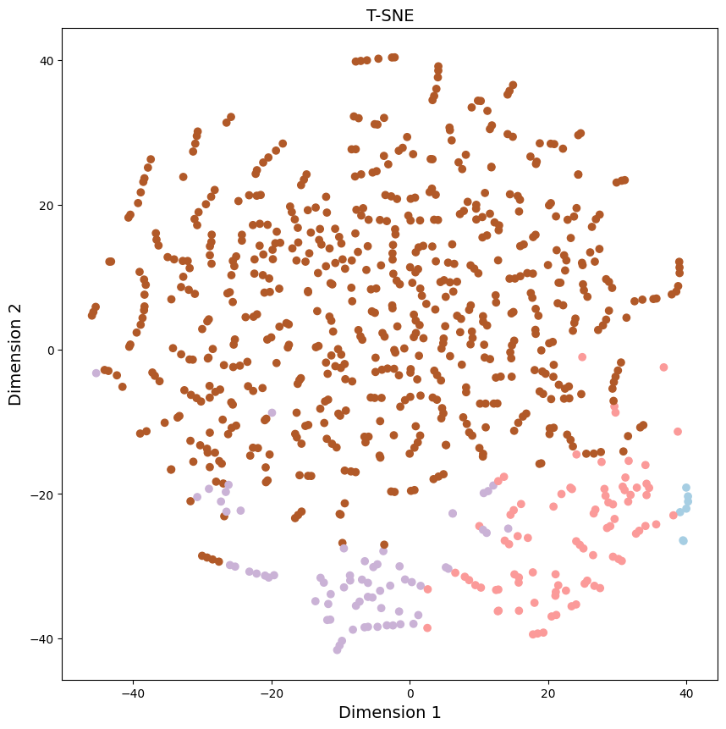
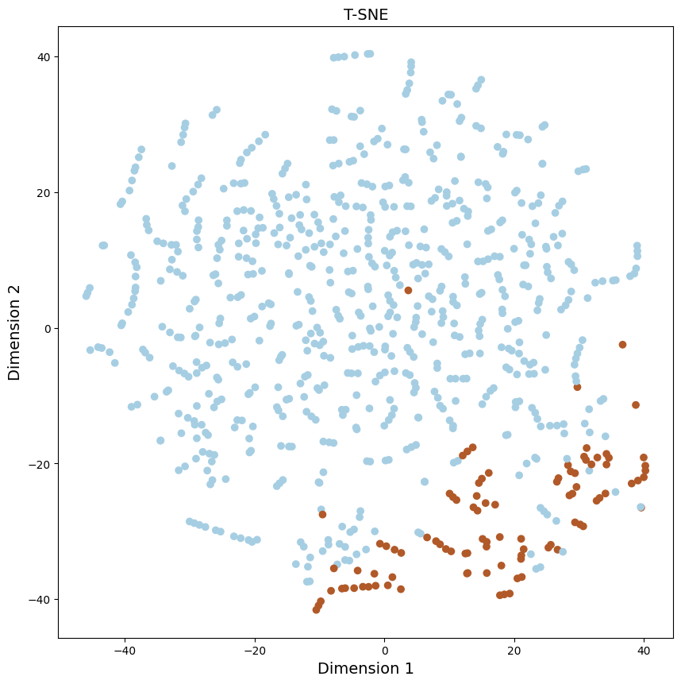
Sampling: Changes to Clusters (K-Means)
TSNE for K-means (k=4)
TSNE for US recession data

Slide 27
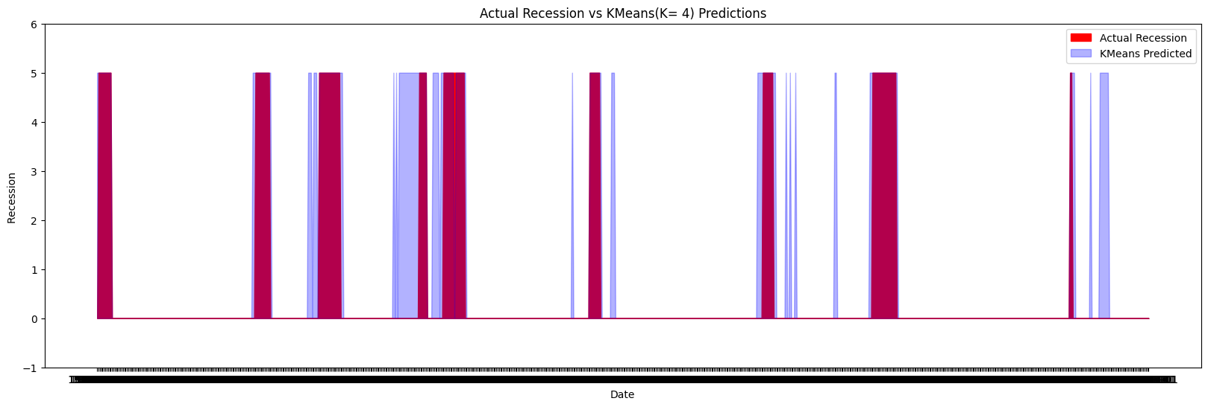
Sampling: Changes to Clusters (K-means)
The following histogram depicts K means (k=4) predictions vs actual US recession data.

Slide 28
Sampling: Changes to Clusters (DBScan)
Just like before Avg. Distances to Nearest Neighbor graph was used to find the elbow points.
After that a loop was implemented to find good eps values.
Then DBScan was fitted on X_s.
DBScan (eps = 7) resulted in 7 clusters + an outlier clusters.
The first 778 lables were stored in a new column.
To examine the results of the algorithm and finding out a mapping logic, TSNE graphs were drawn for DBScan (eps = 7) and actual Recession data.

Slide 29
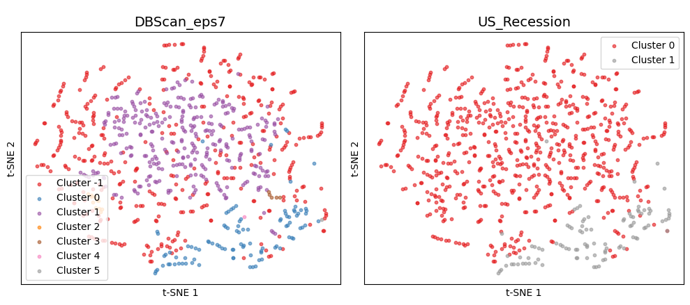
Sampling: Changes to Clusters (DBScan)
A quick glance revealed that there is some overlap between recession points and one of the clusters. To further examine this, legends were added to TSNE plot. As demonstrated by the plot, cluster zero overlaps nicely with recession values.

Slide 30
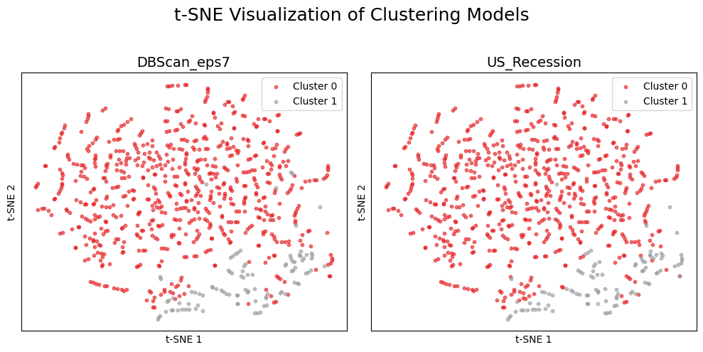
Sampling: Changes to Clusters (DBScan)
Based on the insights gained, cluster zero was assigned to represent recession and everything else was assigned to non recession value. The resulting graph depicts the final predictions using DBScan.

Slide 31
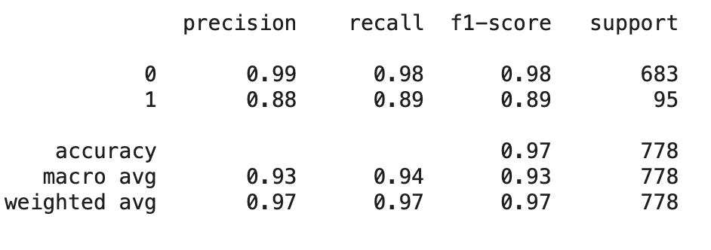
Sampling: Changes to Clusters (DBScan)
The following classification report is generated after mapping the results of DBScan trained using oversampled data, mapped to recession values.

Slide 32
Sampling: Changes to Clusters (GMM)
Similar to before, BIC graph was drawn to find the best k value. Based on the graph, K value of 6 was chosen.
Then the model was fit and predicted on the oversampled data, and the first 778 points were stored in a new column.
To understand and develop a mapping logic for the 6 clusters predicted by GMM, TSNE graph of the predicted GMM clusters and actual US recession values were drawn, as depicted in the following slide.

Slide 33
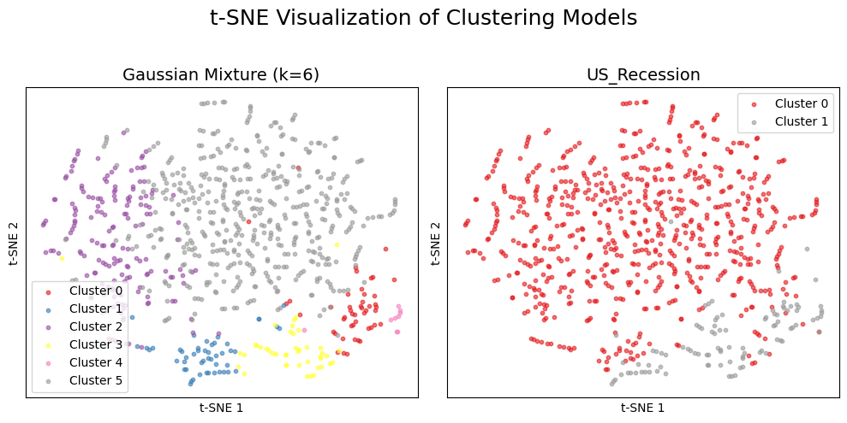
Sampling: Changes to Clusters (GMM)
A quick glance seems to indicate cluster 0,1,3,4, match nicely with recession values.

Slide 34
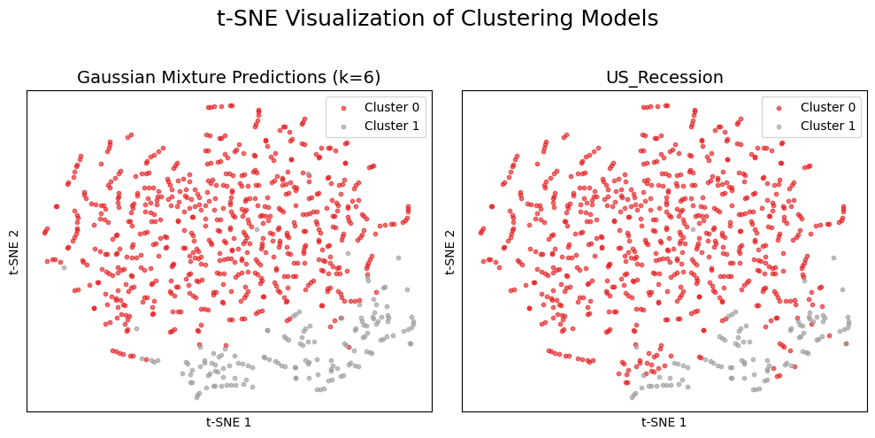
Sampling: Changes to Clusters (GMM)
Based on this results, the mentioned clusters were mapped to indicate recession value of 1. The resulting TSNE graphs are as follows.

Slide 35
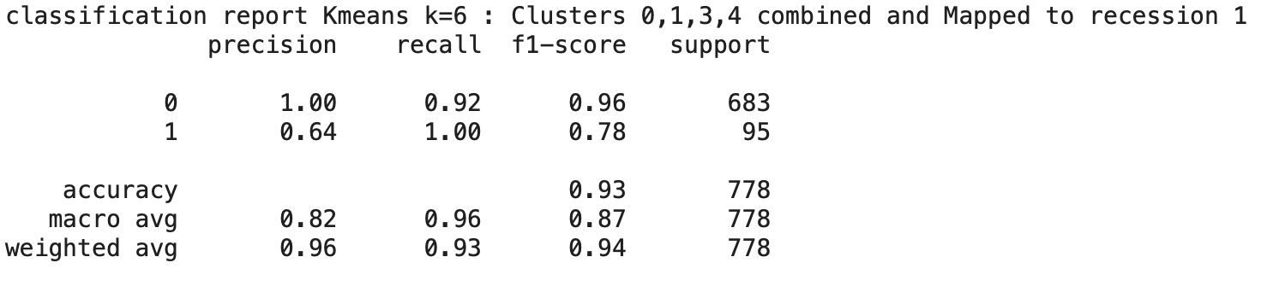
Sampling: Changes to Clusters (GMM)
Finally, the following classification report was generated for the values predicted by GMM with (k=6).

Slide 36
Cluster Analysis: “Best” Model with Sampling
DBScan (eps=7) achieved the best performance in identifying recession months post-SMOTE.
The algorithm balanced precision (0.88) and recall (0.89), resulting in a strong F1-score of 0.89.
It outperformed KMeans and GMM, which had high recall but significantly lower precision.
DBScan produced the highest overall accuracy (0.97) and macro average F1-score (0.93).
DBScan is recommended as the most effective algorithm for detecting recession in this assignment after addressing class imbalance.

Slide 37
Recommendation
Sampling is highly recommended. Without it, models struggled to detect recession months due to severe class imbalance (only ~12% of the data).
SMOTE oversampling provided a balanced dataset, enabling clustering algorithms to more effectively identify recession structures.
After oversampling, DBSCAN (eps=7) achieved a strong balance of precision (0.88) and recall (0.89), resulting in an F1-score of 0.89 and accuracy of 0.97.
In contrast, pre-sampling models either underperformed or had high recall but very low precision (e.g., KMeans k=4).
Sampling revealed structures in the data that unsupervised models failed to detect on their own.

Slide 38
Insights
Macroeconomic indicators carry hidden recession signals. Despite not being explicitly labeled, features like employment rates, industrial production, consumer sentiment, and financial spreads clustered meaningfully around historical recession periods — proving their predictive power when modeled properly.
Imbalanced data masks critical events like recessions. In real-world policymaking or financial planning, underrepresenting rare but impactful events (like recessions) can lead to missed signals. This project shows the importance of balancing datasets to avoid blind spots.
Unsupervised models, when guided by sampling and dimensionality reduction, can uncover hidden economic patterns. DBSCAN, paired with SMOTE and t-SNE, successfully separated recession periods without labels — a valuable capability for early warning systems in economics or finance.
KMeans is simple but limited when working with complex, noisy economic data. Its performance varied significantly with different k values and lacked robustness before sampling.
Data preparation is as crucial if not more as model selection. The combination of PowerTransformer and SMOTE not only improved numerical stability but also helped align the feature space with meaningful economic regimes.

